Slide 1
INFECTION PREVENTION AND CONTROL

Slide 2
INTRODUCTION
Basic principles
Standard precautions
Specific infections
Infection surveillance
Infection prevention group
Audit

Slide 3

CHAIN OF INFECTION
Source - micro-organism, e.g. bacteria, virus, fungi
Reservoir – where source lives e.g. humans, environment, soil
Means of escape - e.g. coughing, vomiting, air currents, contaminated equipment
Mode of transmission – direct (person to person), indirect (person to object to person)
Means of entry - way in which organism enters a host, e.g. ingestion, inhalation,
injection, break in skin

Slide 4

WHAT MAKES SOMEONE SUSCEPTIBLE TO INFECTION?
Lowered immunity
Age – very young or old
Poor physical / psychological well-being
Underlying disease e.g. diabetes
Poor nutrition
Stress
Medical intervention: drug therapies, e.g. chemotherapy, steroids & antibiotics and presence of invasive devices, e.g. urinary catheters, intravenous infusions etc.
Anyone can be susceptible if exposed to blood borne viruses

Slide 5
INFECTION PREVENTION MANUAL
Provides:
  Guidance to minimise risk of infection
  Information on specific infections
  Action to take in event of an outbreak
  Results of infection surveillance
  Minutes from IPC team meetings
Can be found on both wards (hard copy) or on computer system O/H drive

Slide 6

STANDARD PRECAUTIONS underpin routine safe practice protecting patients and staff

Slide 7
STANDARD PRECAUTIONS INCLUDE:
Achieving optimum hand hygiene
Appropriate use of clinical personal protective equipment
Safe handling and disposal of sharps
Safe handling and disposal of clinical waste
Managing blood and bodily fluids
Decontaminating equipment
Achieving and maintaining a clean environment
Appropriate use of indwelling devices
Managing accidents
Good communication
Training/education

Slide 8
HAND HYGIENE
Infections (including MRSA) most commonly spread via hands of healthcare workers in hospital and other health care settings
SINGLE MOST IMPORTANT ACTIVITY IN REDUCTION OF SPREAD OF INFECTION AND PREVENT PATIENTS ACQUIRING INFECTION IN HOSPITAL
Hands must be cleaned before and after patient contact and after any task with a risk of hand contamination
Hands may be decontaminated by hand-washing or use of alcohol hand rub
In addition clinical staff should:
  Keep nails short, clean and polish free
  Avoid wearing jewellery or wristwatches especially rings with ridges or stones
  Not wear artificial nails
  Cover cuts or abrasions with a waterproof dressing

Slide 9

EQUIPMENT
Conveniently situated hand basins
Wrist, elbow or automatic taps
Plentiful supply of paper towels in dispensers that allow easy access
Liquid soap and hand lotion in disposable cartridges
Alcohol hand rub in each patients’ room

Slide 10
HAND HYGIENE METHODS
The two favoured hand hygiene methods are soap and water and alcohol based hand rubs
Better at removal of debris – preferred option when hands are visibly soiled
Removal of clostridium difficile spores - alcohol based hand rubs are less effective at removing spores than soap and water
Faster and easily accessible
Less time needed
Less hand irritation – compared to repeated use of soap and water
Less risk of re-contamination
Increased usage – several studies have reported increased rates of hand hygiene compliance after introduction of alcohol based systems
Advantages of soap and water
Advantages of alcohol hand rub

Slide 11
HAND WASHING PROCEDURE
Roll up sleeves
Run water till hand hot, direct flow away from plughole and run at a rate that does not splash
Wet wrists and hands with running water
Apply liquid soap to all surfaces of hands and wrists
Lather surface for 10-15 secs
Pay attention to nails, finger pads, thumbs and between fingers
Do not use a nail brush
Rinse hands under running water
Hold hands downwards to drain water from fingertips
Turn off taps using elbow or paper towels
Dry hand thoroughly with paper towel
Dispose in foot operated bin

Slide 12
PROCEDURE FOR USE OF ALCOHOL RUB
Do not wet hands
Dispense requires amount into palm of hand
Spread thoroughly over both hands and wrists
Pay attention to nails, finger pads, thumbs and between fingers
Rub vigorously till dry

Slide 13
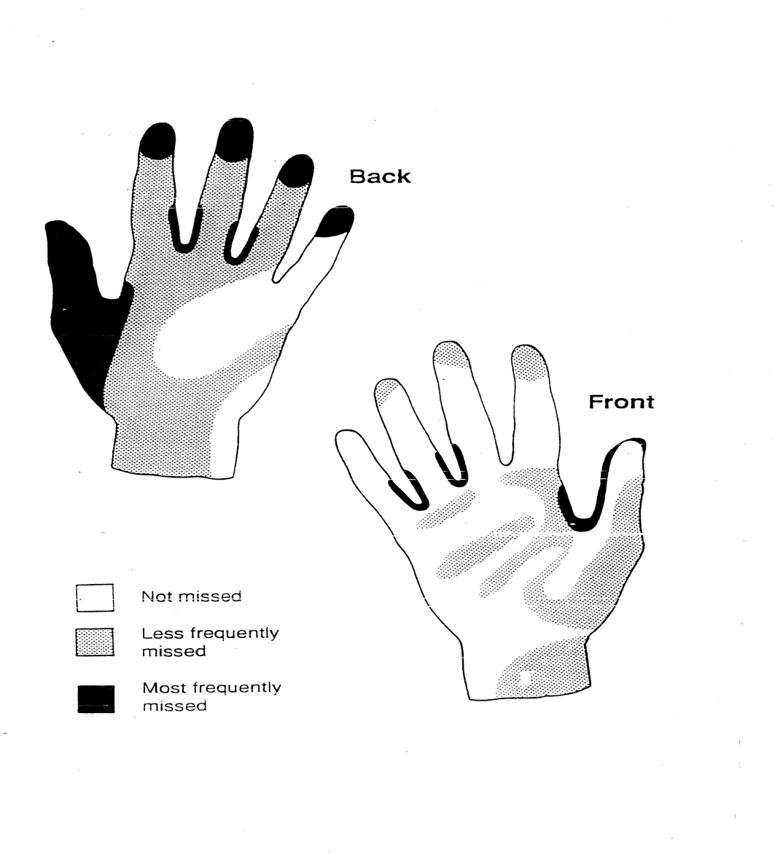
AREAS COMMONLY MISSED FOLLOWING HAND CLEANING

Slide 14
HAND DECONTAMINATION:
Before:
Performing invasive procedures
Contact with a patient
Preparing, handling or eating food
Dispensing medicines
Starting a shift

Slide 15
HAND DECONTAMINATION
After:
Contamination
Removal of gloves
Contact with a patient
Using the toilet or toileting others
Bed-making and handling laundry
Handling contaminated waste
Finishing a shift

Slide 16
LOOK AFTER YOUR HANDS!!!
Damaged skin does not provide a barrier to infection and may become colonised
Keep your skin in good condition by using hand lotion regularly

Slide 17

PERSONAL PROTECTIVE EQUIPMENT
Used to protect patients and staff from risks of cross infection
Includes:
  Gloves
  Aprons
  Goggles

Slide 18
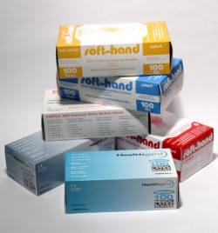
DISPOSABLE GLOVES
Used when carrying out tasks with a risk of exposure to blood or bodily fluids or aseptic procedures
Effectiveness depends on correct and appropriate use
Single use item -put on immediately before contact , remove immediately afterwards
Must be changed between patients and between different care or treatment activities for same patient
Inappropriate use of gloves can result in cross contamination from one part of a patient’s body to another and in some cases lead to serious infection
Gloves are hazardous waste - dispose in tiger bins.
Always wash your hands on removal of gloves

Slide 19

PLASTIC APRONS
Worn to prevent contamination of clothing:
  Direct patient care
  Bed-making
  Decontaminating equipment
  Waste disposal
Discard as soon as task complete and wash hands
Store safely to prevent dust accumulating

Slide 20
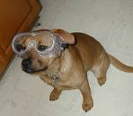
GOGGLES
Should be worn during procedures where there is a risk of splashing
Masks may be necessary if there is a risk of airborne infection e.g. multi drug resistant Tuberculosis (TB), SARS

Slide 21
SAFE HANDLING AND DISPOSAL OF SHARPS
Main hazards are hepatitis and HIV
2nd only to back injury as a cause of occupational injuries in health care workers
Safe use and disposal vital in reducing risk

Slide 22
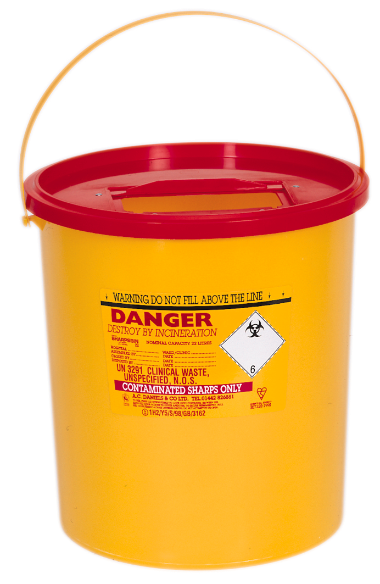
WE ARE ALL RESPONSIBLE TO ENSURE THAT THE SHARPS BIN CAN BE SAFELY USED, PERMANENTLY SECURED AND TRANSPORTED FOR DISPOSAL WITHOUT FEAR OF SPILLAGE

Slide 23
SHARPS AWARENESS
Close temporary closure when not in use
Lock when 2/3rds full
Assemble it correctly.
Snap lid on all round
YOUR RESPONSIBILITIES
Notes:
YOUR RESPONSIBILITIES – this shows the responsibilities of the users.
Must be locked when two thirds full.
Temporary closure in place when not in use.
Correct assembly of Sharpsbin.
Place in a safe are and position.
Enter details - Hospital
Ward/dept
Assembled by
Closed by

Slide 24

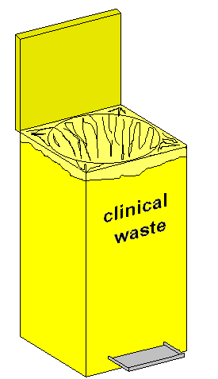

WHAT IS THE CONSEQUENCE OF THIS ACTION?

Slide 25
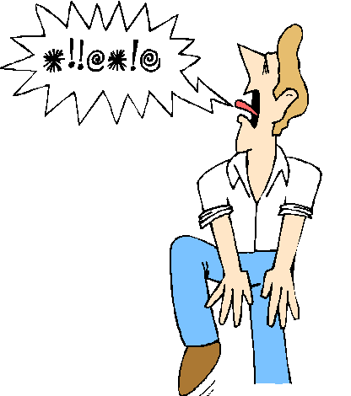

IF YOU DON’T GET THE POINT SOMEONE ELSE WILL!
SO…...

Slide 26

DISPOSE OF SHARPS INTO DESIGNATED SHARPS BIN

Slide 27
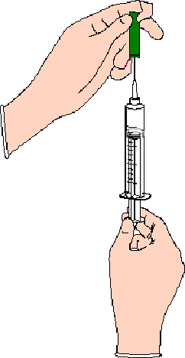
DO NOT RE-SHEATH NEEDLES
NO

Slide 28
DON’T CARRY SHARPS UNNECESSARILY

Slide 29
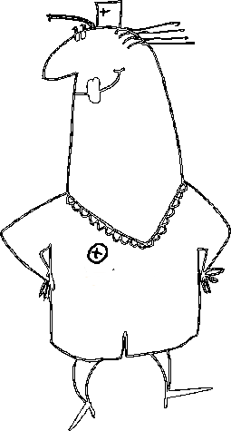

ALWAYS DISPOSE OF YOUR OWN SHARPS

Slide 30
NON CO-OPERATIVE PATIENT?
GET HELP

Slide 31
SHARPS INJURY
BLEED IT
WASH IT
REPORT IT

Slide 32
Sharps Injury
Consult with the Senior Nurse on duty for further advice
The patient involved in the sharps injury to be screened for infection status
Report to HR, you might need to be referred to the Occupational Health Nurse

Slide 33
THIS IS YOUR RESPONSIBILITY

Slide 34
MANAGEMENT OF BODY FLUID SPILLAGE
Use personal protective clothing
Keep visitors and patients away from spill area
Body fluids e.g. urine & faeces, NOT visibly blood stained, clean using hot water and detergent
For blood spillages to hard surfaces use sodium hypochlorite solution. Contact time at least 2mins. Clean spill area with hot water and detergent
Contact housekeeping for deep cleaning

Slide 35
DECONTAMINATING EQUIPMENT
Outbreaks associated with dirty equipment
Decontamination ensures re-usable items are safe
Combination of cleaning; disinfection and sterilisation

Slide 36
RISK ASSESSMENT
 | Equipment | Level of cleaning | Examples
HIGH RISK | Equipment that: Enters a sterile body cavity Penetrates skin Touches a break in the skin | Equipment must be fully cleaned and sterilised after each patient use. | Surgical instruments
MEDIUM RISK | Equipment that touches intact skin or mucous membranes | Equipment does not need to be sterile at the point of use but needs to be cleaned and sterilised between each patient | Bedpans Urinals
LOW RISK | Equipment that does not touch broken skin or mucous membranes or is not in contact with patients | Equipment must be cleaned and/or disinfected after use | Ophthalmoscope Bed cradle

Slide 37
Waste Management
Correct use of bins
White – house waste
Yellow – Offensive non hazardous waste
Orange – Hazardous clinical waste
Correct use of buckets – transport from patient’s room to soiled holding
White – Incontinence waste
Grey/blue – unsoiled bed linens/ clothes Any soiled items go to RED BAG
Correct use of laundry bags
Green – unsoiled items
Red – soiled items

Slide 38

SINGLE USE EQUIPMENT
Single use – used on a single occasion then discarded
Single patient use – used on multiple occasions on same patient then discarded e.g. suction tubing

Slide 39
SINGLE USE EQUIPMENT
Prior to use:
  Check properly sealed
  Check within expiry date
  Check correct item

Slide 40
ACHIEVING AND MAINTAINING A CLEAN ENVIRONMENT
Bacteria can survive for long periods in the environment
Can live quite happily in dust
High standards of cleanliness helps reduce infection risks and increases public confidence
Detergent and water is suitable for most purposes
Cleaning clothes used for specific purposes and areas
Buckets and mops stored clean and dry
Operational standards document

Slide 41
APPROPRIATE USE OF INDWELLING DEVICES
Urinary catheters
Enteral feeding tubes
Tracheostomy tubes
Correct techniques vital to prevent acquired infections
General guidance in Clinical and IPC manuals
Information related to specific patients in relevant section of care plan

Slide 42
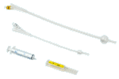
URINARY CATHETERS
Increased risk of UTI in catheterised patients (UTI commonest cause of bacteraemia in patients in long term care)
Assess need
Look at alternatives
Review regularly
Remove ASAP
Care plan

Slide 43
URINARY CATHETERS -Drainage options
Intermittent catheterisation
Smallest gauge catheter
Sterile closed drainage system – do not break connection unless changing bag
Bags positioned below bladder level – not too low on leg and definitely not on floor
Empty bags frequently

Slide 44
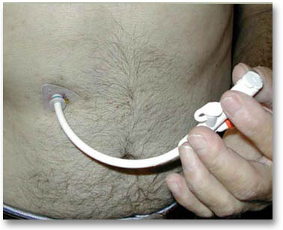
ENTERAL FEEDING
Minimal handling
Pre- packaged feeds used
Administration system compatible with tube – changed weekly
Feeds stored according to manufacturer’s recommendations
Keep stoma site clean
Dressings not necessary
Tubes changed according to manufacturer’s recommendations
Tubes flushed with fresh tap water unless otherwise indicated

Slide 45
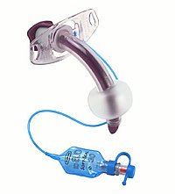
TRACHEOSTOMY
Keep area clean and dry
Clean with normal saline
Frequency of dressing changes depends on secretions
Suctioning as required by individual patients
Tracheostomy tubes changed 4 weekly
Inner tubes at least every 4 hours
Inner tubes cleaned with warm water and cleaning swab, dried and stored in plastic sealed container
‘Swedish noses’ changed as required
Piped and portable suction unit

Slide 46
Specific Infections
MRSA
Gastroenteritis
Clostridium Difficile
Influenza

Slide 47
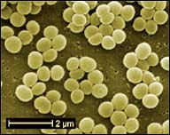
MRSA
Staphlococcus resistant to Methicillin and some other antibiotics but remains treatable
Staphlococcus aureus found on 30-40% of population, has been around for decades
MRSA carried by 2% of population with no symptoms or ill effects
Only becomes a problem when normal body defences compromised e.g. by surgery or trauma
Infections (including MRSA) can be treated with a number of antibiotics

Slide 48
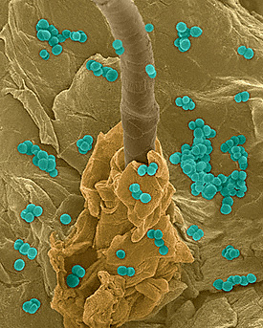
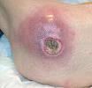
MRSA
Colonisation:
No symptoms
Swabs or samples will grow the bacteria
Can be colonised in:
  moist areas
  rough or damaged skin
  chronic wounds
Infection:
Pain & fever
Redness & swelling
Unpleasant discharge
Wound breakdown
Can be life threatening if bacteria gets into deep tissues or blood stream

Slide 49
WHAT TO DO
Routine screening not necessary
Treat colonisation only if patient undergoing invasive procedure i.e. surgery
No need to re- screen unless clinical indication e.g. admission for surgery
Prevention better than cure - standard precautions/good hand decontamination
No need to isolate unless bacteria can not be contained
Can have visitors and go out
Laundry does not need to be segregated – wash on hottest temperature, personal items 40°C

Slide 50
GASTROENTERITIS
Infection of GI tract
Affects approx 1 in 5 of population each year
Symptoms caused by toxins produced by virus or bacteria irritating the GI tract causing excess fluid production
Usually symptoms subside without specific treatment

Slide 51
GASTROENTERITIS - symptoms
Incubation period (time between catching infection and beginning of symptoms) can range from a few hours to weeks
Symptoms may include:
  • Diarrhoea
  • Nausea
  • Vomiting
  • Abdominal pain or cramps
  • Feeling bloated
  • High temperature
Seek medical advice if symptoms persist

Slide 52
GASTROENTERITIS - causes
Infection occurs after eating or drinking contaminated food, contact with infected person or with contaminated surfaces or equipment
Virus
Bacteria
Parasites

Slide 53

CLOSTRIDIUM DIFFICILE
Spore forming bacteria, present as one of the normal gut bacteria in 3% of adults
Causes illness when normal balance is disturbed by antibiotics
Another reason to use antibiotics carefully
80% of reported case are >65 yrs
Can be carried without symptoms
Symptoms develop when C Diff multiplies and produces toxins
Laboratory testing to confirm diagnosis then treatment with antibiotics

Slide 54
SPREAD OF C DIFF
Can spread from person to person as the sufferer sheds spores in their faeces
Spores can live a long time on surfaces
Can be transported in the air e.g. when making beds
Can be transported on the hands after contact with infected persons or surfaces

Slide 55
ACTION
Good communication
Isolate with own toilet or commode until formed stool for 48hrs
Gloves and aprons for all care – remember to change gloves for each care task
Keep linen separate – wash on hot cycle
Increased environmental cleanliness
Stool sample for testing

Slide 56
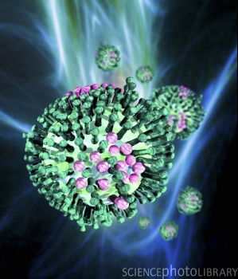
INFLUENZA

Slide 57
INFLUENZA - TYPES
Type A
  Found in animals and humans
  2 surface proteins – haemagglutinin (H) neuraminidase (N) used to classify into subtypes e.g. H1N1 etc.
  Natural reservoir aquatic birds, all subtypes are found in them, only some are found in mammals
Type B
  Similar symptoms to type A, but not as serious.
Type C
  The mildest type, symptoms similar to a cold

Slide 58
TRANSMISSION
Incubation period up to 5 days
Virus is shed in secretions from respiratory tract
Spread by droplets produced by coughing and sneezing

Slide 59
PREVENTION - vaccination
Recommended for:
  Specific groups of patients e.g. elderly, pregnant women, chronic respiratory or other diseases, diabetics
  All health care workers with direct patient contact
Provided by Occupational Health Nurse at Holy Cross
Cost effective for target groups
DOES NOT cause flu – usually given in coughs and colds season so often blamed

Slide 60
SYMPTOMS
Acute illness lasts 3-5 days full recovery takes much longer, symptoms may include:
  High temperature
  Feeling unwell
  Headache
  Muscle and joint pain
  Dry cough
  Sore throat
Treatment is usually to treat symptoms
Anti-virals can be given to high risk groups or during pandemics

Slide 61
Infection Surveillance
Infection notification
Use of antibiotics
Local lab – Frimley Park Hospital
Infection records

Slide 62
Infection Prevention Group
Committee members
Meeting bimonthly
Standard/objectives
Meeting minutes
Audit planner/tool/report
Action plans

Slide 63
AUDIT
Audits undertaken every year to:
  Check policies and guidelines are effective
  Ensure training and communication is effective
  Identify training needs

Slide 64
ANNUAL IPC AUDITS
Hand hygiene
PPE –clinical
Equipment cleanliness
Waste disposal
Ward kitchen
Management of blood and bodily fluid spillage and/ or contamination
Prevention and management of sharp injuries, bites and splashes
Specimen handling
Decontamination of equipment
Catheter management (CG)
Enteral feeding management (CG)
Tracheostomy management (CG)

Slide 65
FOR LISTENING
ANY QUESTIONS

